Slide 1

Airbnb Listings in London, United Kingdom
March 17, 2022
Barcelona
Demi Vinke
Fabrizio Rocco
Vincent Standler
Vivien Laurent
Damla Yalçın

Slide 2





OUR TEAM MEMBERS
Demi Vinke
Fabrizio Rocco
Vincent Stadler
Vivien Laurent
Damla Yalçın

Slide 3


TABLE OF CONTENT
01
Problem and Motivation
02
Airbnb Data London
03
Recommendation System
04
Price Prediction
05
Sentiment Analysis - NLP
06
Impact on Airbnb’s Business Model and Revenue

Slide 4
PROBLEM AND MOTIVATION
There are a growing number of apartments on Airbnb, and it can be
very difficult for a new landlord to understand:
What does it take to stand out?
How to price correctly?
How to know what guests appreciate regarding service?
PROBLEM
A platform that landlords can subscribe to for three main features:
Getting similar apartment suggestions
Getting a pricing range based on similar apartments
Getting an idea of what services are valued by customers
WHAT WE OFFER…
Interesting to design a platform that can resolve these problems
Creating a platform that Airbnb could offer as a paid service
Opportunity to use multiple AI techniques
MOTIVATION

Slide 5
ABOUT THE DATA
01
02
03
CITY
DATASET
INFORMATION
London,
England,
United Kingdom
All datasets of London Airbnb listings have been used
Detailed & summary information about listings, reviews & neighborhood
Notes:
Source:
- Data: http://insideairbnb.com/get-the-data.html

Slide 6
LISTINGS RECOMMENDATION
Understanding the Problem
For a new landlord in Airbnb platform, it would be difficult to have an idea of similar apartments. Therefore, our aim is to provide a recommender system that can show the 5 most similar apartments to understand how the competitors are doing.
Understanding the Data
Airbnb London listings data contains 66641 instances and 74 columns.
24 of features have ‘float’, 17 of features have ‘int64’, and 33 of them have ‘object’ type.
3 variables contain roughly 32000, and 8 variables contain approximately 18000 missing values
Preprocessing the Data
Several regex functions (lowercase, alphanumerical, amenities)
Only 6 columns are necessary for this use case
Recommendation System
Price Prediction
Sentiment Analysis

Slide 7
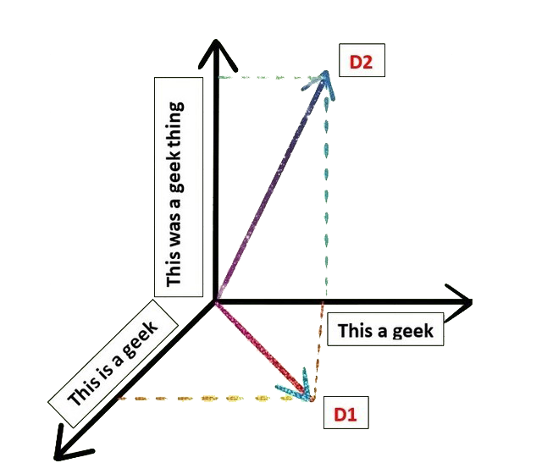
ALGORITHMS SPECIFICITIES: COSINE SIMILARITY
Cosine Similarity measures the cosine angle between two vectors
projected in a multi-dimensional space
In the sklearn module, there is a built-in function called cosine_similarity()
to calculate the cosine similarity.
The smaller the angle the higher the cosine similarity
When the vectors are pointing in the same direction it means
that they are similar.
Recommendation System
Price Prediction
Sentiment Analysis
Figure 8: Cosine similarity

Slide 8
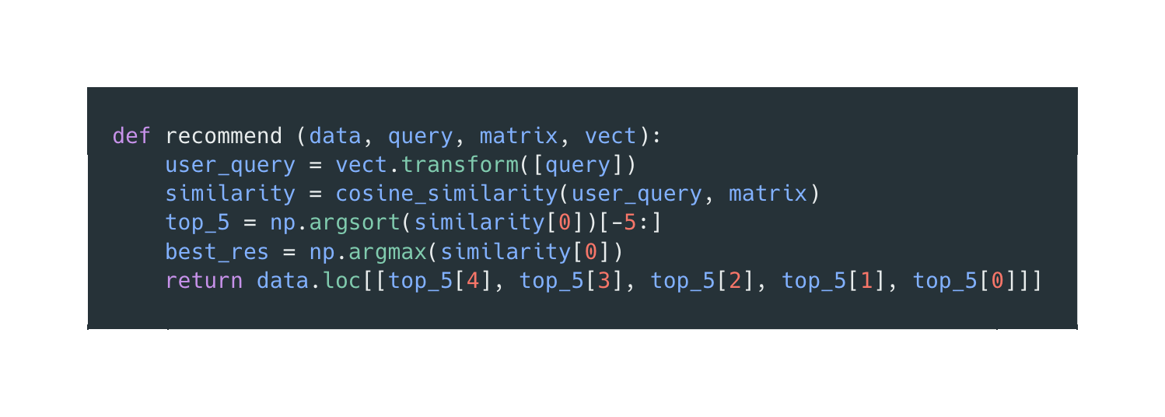
THE RECOMMENDER FUNCTION
Vectorize the query inputted by the user
Cosine similarity between user’s vector and matrix
Sort the 5 most similar listings
Return the top 5 in the web app
Recommendation System
Price Prediction
Sentiment Analysis
Figure 8: Cosine similarity

Slide 9
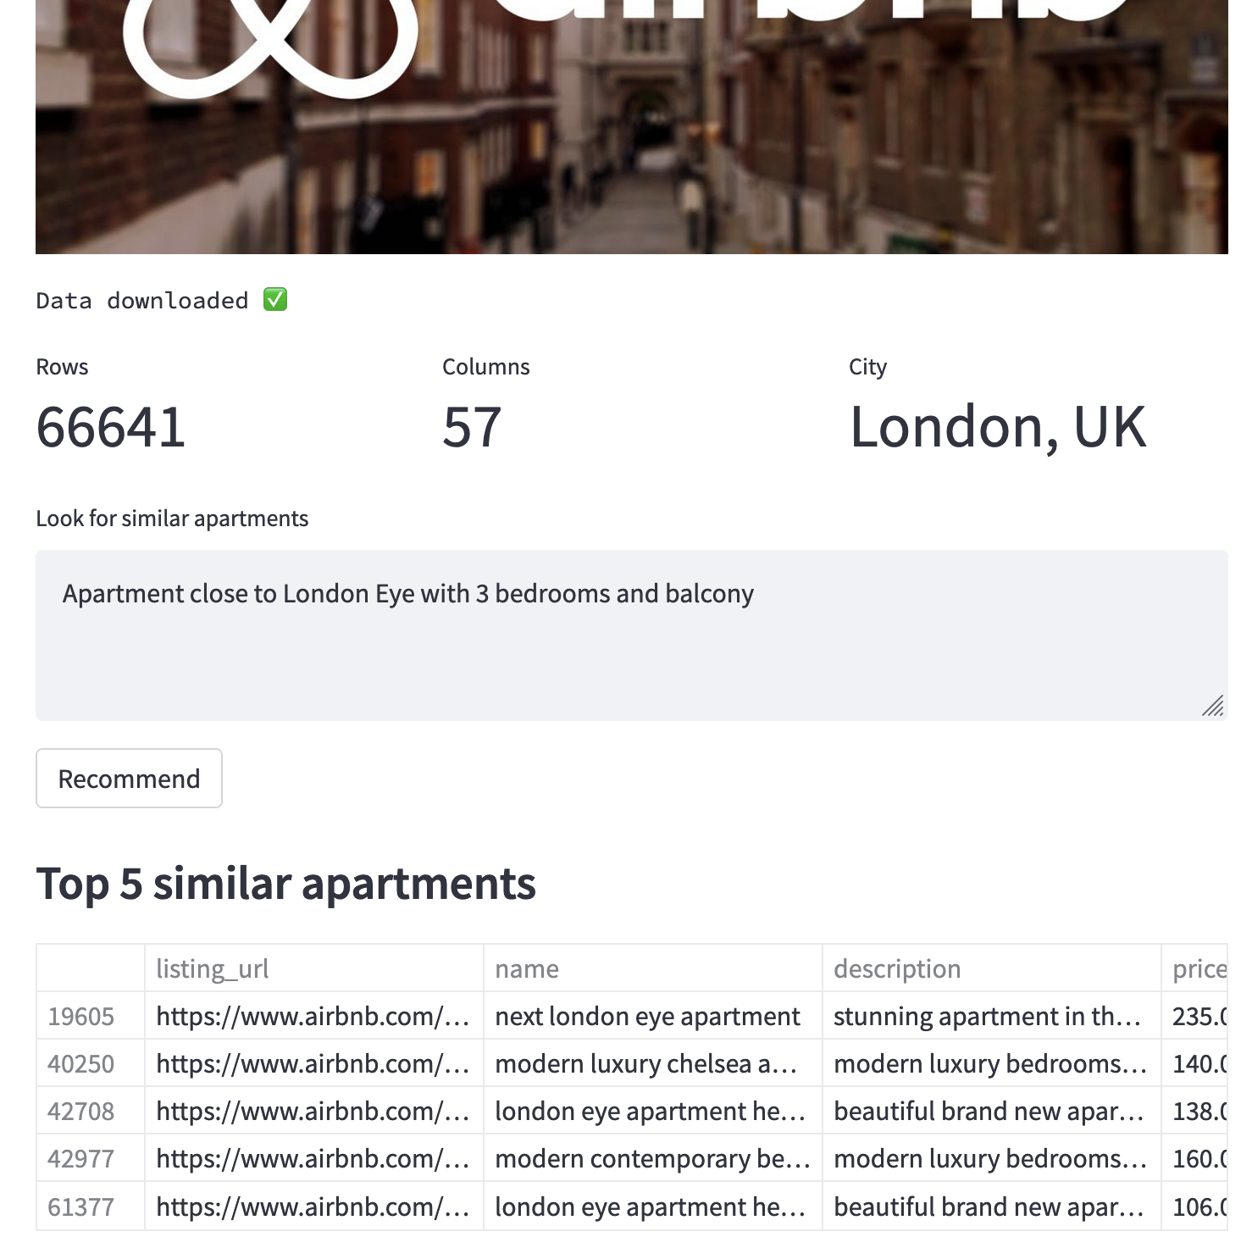
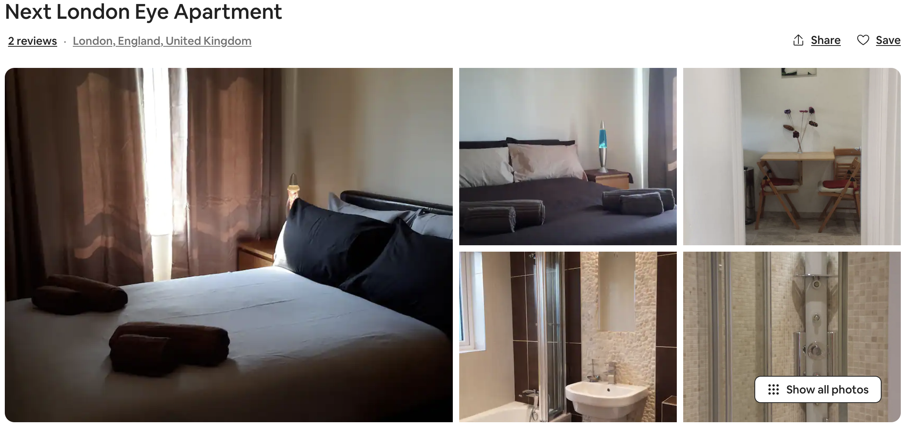
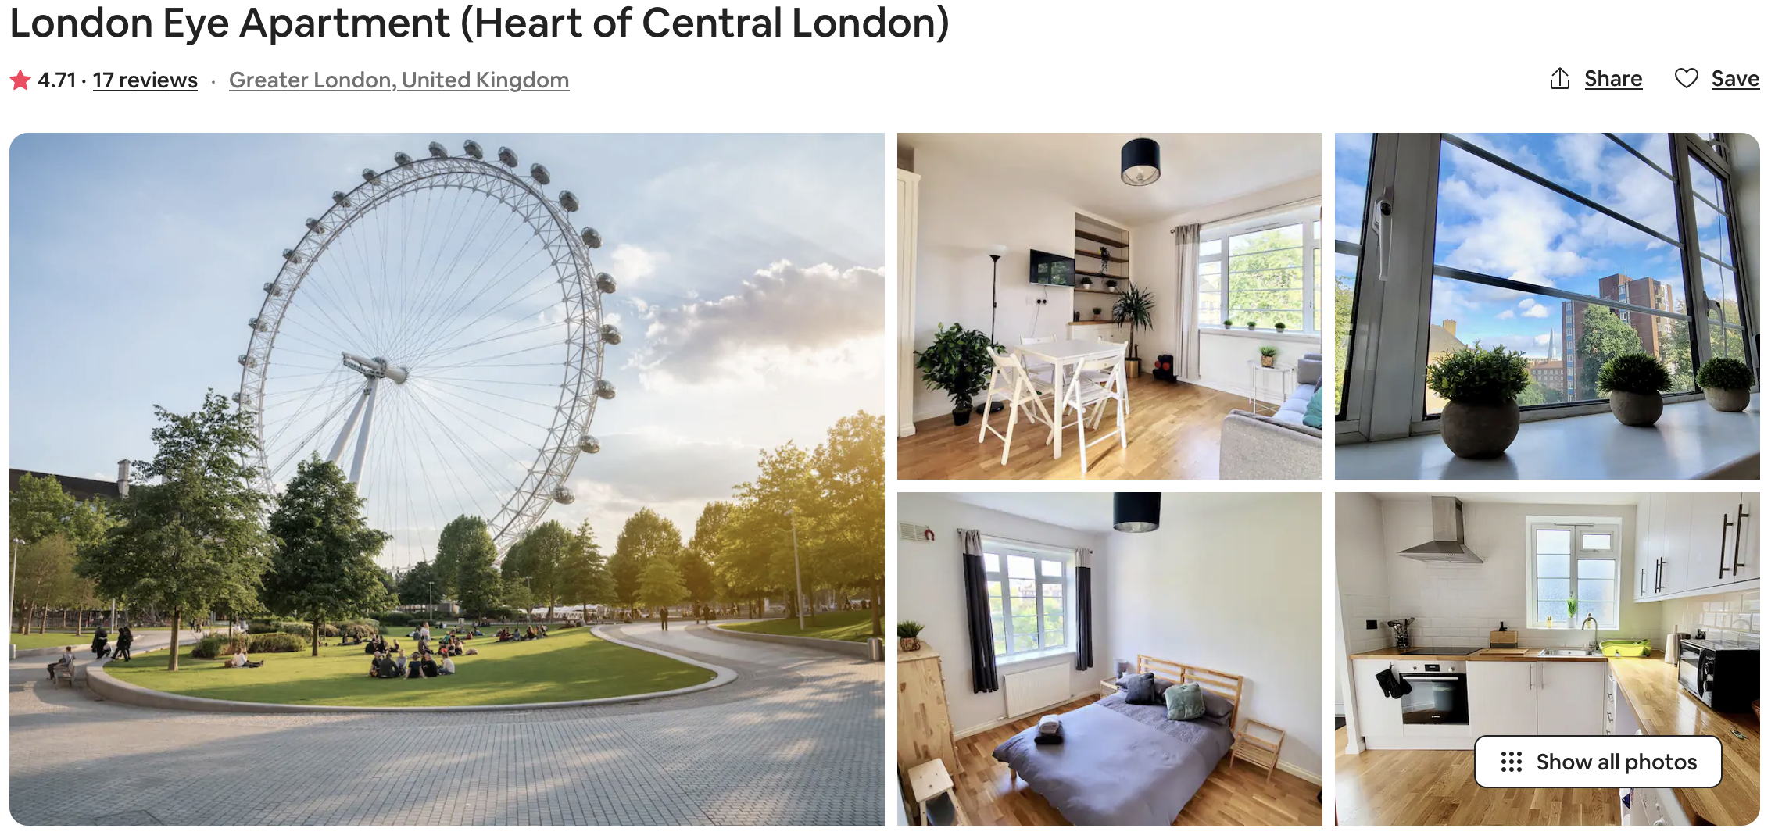
RECOMMENDATION IN ACTION
Recommendation System
Price Prediction
Sentiment Analysis
Figure 8: Cosine similarity

Slide 10
PRICE PREDICTION
Understanding the Problem
For a new landlord in Airbnb platform, it would be difficult to predict price correctly. Therefore, our aim is to provide a pricing range to a new landlord based on similar apartments.
Target Variable: Price (Regression Problem)
Understanding the Data
Airbnb London listings data contains 66641 instances and 74 columns.
24 of features have ‘float’, 17 of features have ‘int64’, and 33 of them have ‘object’ type.
3 variables contain roughly 32000, and 8 variables contain approximately 18000 missing values
Preprocessing the Data
Depending on the correlation, having missing values and data type:
41 columns have been removed.
All categorical variables have been either one-hot or label-hot encoded manually.
Recommendation System
Price Prediction
Sentiment Analysis

Slide 11


PREPROCESSING STEPS
Removing Outliers
Filling missing values
Cleaning Numerical Features
Encoding Categorical Features
Variance Threshold
We removed the outliers from price (greater than or equal to 1195)
We filled 8 variables with the median and 2 with ratios derived from other variables
We removed the symbols from the variables
($, %)
Depending on unique values and mean of the features, we have used one-hot and label-encoding
We used a feature selector algorithm which only looks at the predictors (X), not the prediction target (y), and removes all low-variance features
Variance Cutoff: 80% same value
Recommendation System
Price Prediction
Sentiment Analysis

Slide 12
PREPROCESSING AMENITIES
Cleaning symbols from amenities and storing
them in a new variable called ‘amenities_list’
Length of amenities_list is 65875
Dropping duplicates and storing
them in a new variable called ‘amenities’
Length of amenities is 2516
Removing all columns where no more than
13000 houses have that amenity (20% of the data)
Number of remaining amenities is 28
Recommendation System
Price Prediction
Sentiment Analysis

Slide 13
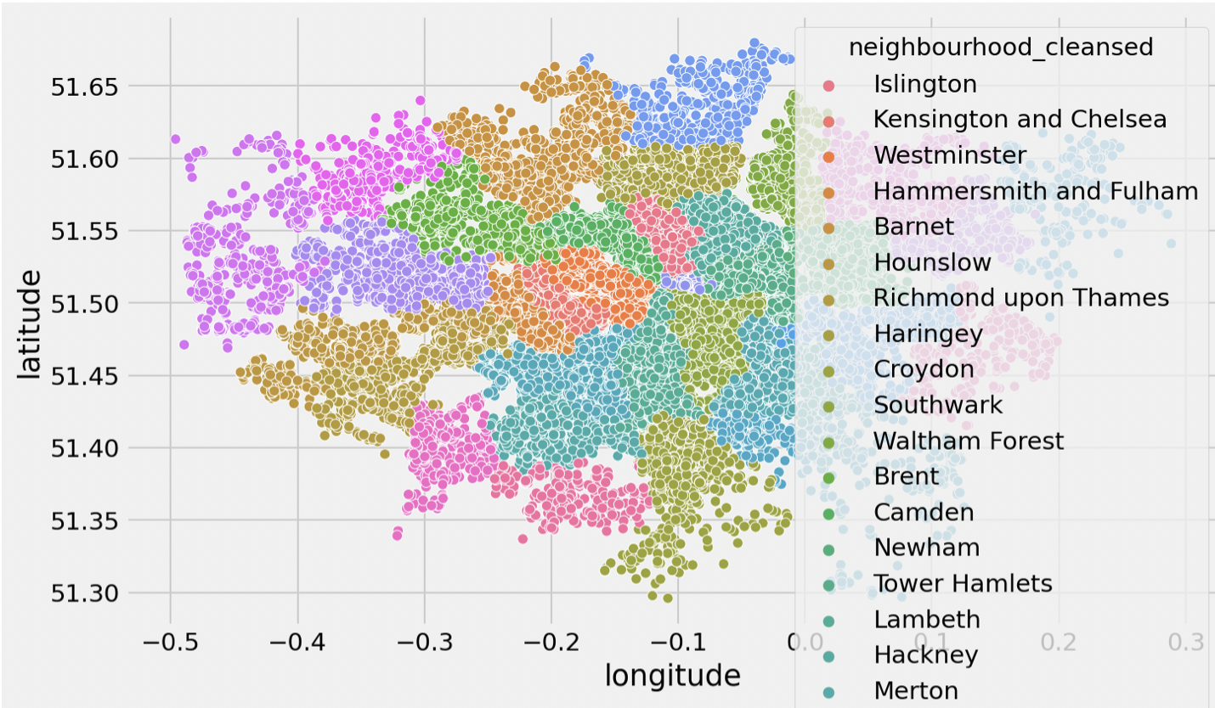
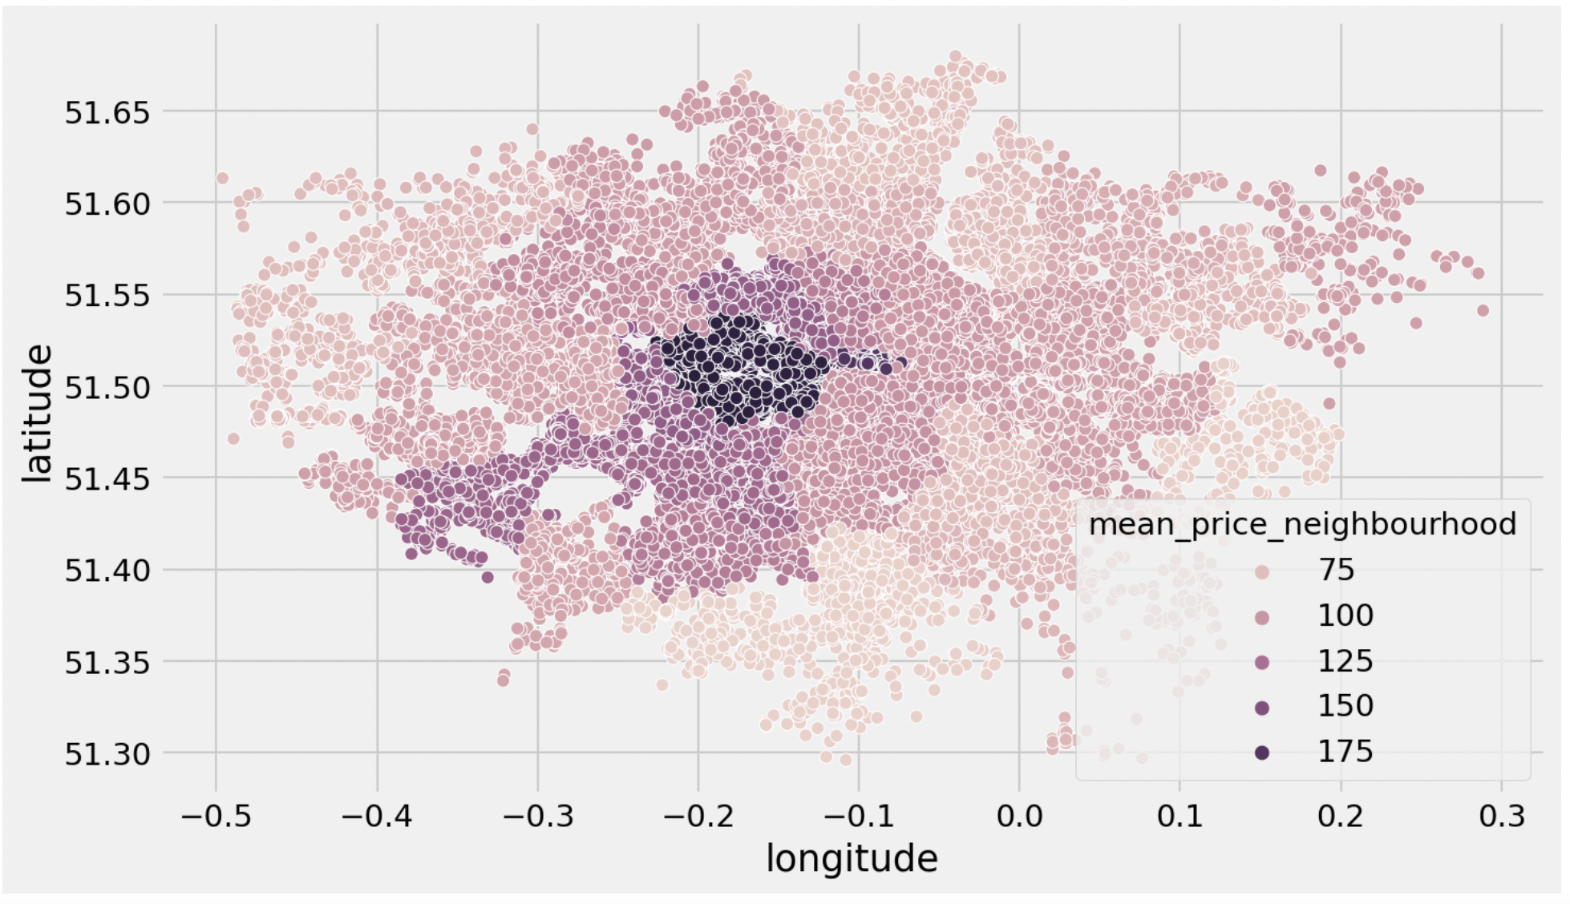
PREPROCESSING NEIGHBORHOOD
Neighborhood data of London was problematic in terms of the numbers and differences of neighborhoods.
We have grouped the neighborhood data according to average price and label-encoded depending on the new price range we obtained.
The most expensive neighborhood depending on the average price values are located at the center of London.
Recommendation System
Price Prediction
Sentiment Analysis

Slide 14
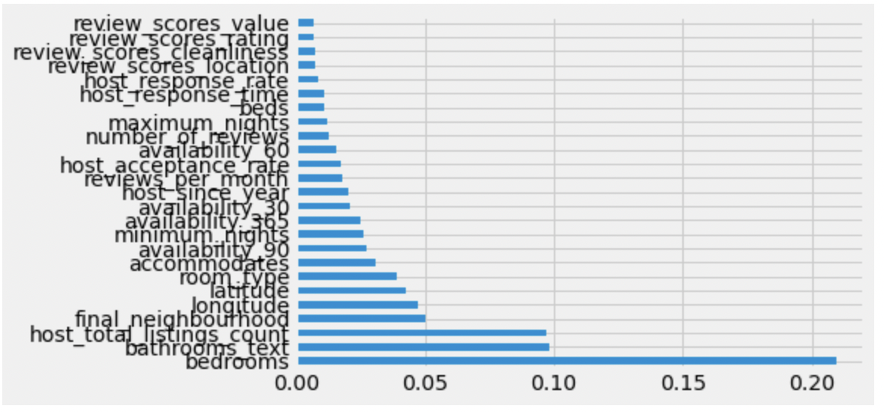
TRAINING MACHINE LEARNING MODELS
We have split the data according to 80:10:10 ratios to obtain train, validation, and test splits.
We trained a Linear Regression and a Decision Tree Classifier as initial models.
These models could not explain much of the variance
We have selected the top 25 features with the largest feature importance and trained a Random Forest Regressor and a Gradient Boosting Regressor.
 | R Squared
Linear Regression | 0.4524
Decision Tree Classifier | 0.0519
Recommendation System
Price Prediction
Sentiment Analysis

Slide 15
TRAINING MACHINE LEARNING MODELS
The five situations in which we trained models:
Running a base model
Finding the best parameters for this model
Creating two new features
Removing all but the 25 most important features (two features not included)
Using the created features, as well as removing features
 | Base |  | Grid search |  | Feature engineering |  | Feature removal |  | Feature removal and engineering
 | R² | RMSE | R² | RMSE | R² | RMSE | R² | RMSE | R² | RMSE
Random Forest Regressor | 0.704 | 34.245 | 0.644 | 37.540 | 0.632 | 38.488 | 0.665 | 37.260 | - | -
Gradient Boosting Regressor | 0.659 | 36.762 | 0.739 | 32.192 | 0.737 | 32.567 | 0.681 | 36.454 | 0.669 | 36.935
Recommendation System
Price Prediction
Sentiment Analysis

Slide 16
THE BEST MODEL
Best Model | Test set result |  | Validation result
 | R² | RMSE | R² | RMSE
GBR | 0.716 | 34.141 | 0.724 | 34.678

Slide 17
UNSUPERVISED LEARNING ALGORITHM
Understanding the Problem
For a new landlord in Airbnb platform, it would be difficult to understand the key patterns in hosts reviews and comments. Our aim is to use Sentiment Analysis to show which services are valued.
Outcome: word cloud for negative and positive comments, examples of positive and negative reviews.
Understanding the Data
We have used ‘reviews’ and ‘listings’ data as well as ‘neighbourhood’ to as input data.
There are almost 2 million reviews in the data set.
Preprocessing the Data
We have detected missing values and systematically non-useful comments and removed them.
14375 features contained ‘The host canceled this reservation.’
We have also dropped dashes, numeric, escape characters and comments that only contain ‘.’
Recommendation System
Price Prediction
Sentiment Analysis
Notes:
Sentiment Analysis is a great tool to understand the relative success of a listing, the good points, things to improve.

Slide 18



PREPROCESSING STEPS
Removing missing values and non-interpretable ones
Text Cleaning
Language Cleaning
Visualization & Sentiment Analysis
We dropped rows without comments and where host cancelled
We removed the commonly used ‘stop words’ using NLTK (Natural Language Toolkit)
We kept only English comments using langdetect (language detection library)
We calculated the polarity of comments and visualized the analysis on an interactive map:
Word Cloud
Recommendation System
Price Prediction
Sentiment Analysis
Notes:
For sentiment analysis to be meaningful, text cleaning is required to remove commonly used words such as “a”, or “to”,
as well as get the common root of verbs “seeing -> see”.

Slide 19

SENTIMENT ANALYSIS – ESTIMATING POLARITY WITH VADER
To analyze the sentiment of comments and extract relevant
information from them we needed a measure to score how positive or
negative they are.
To achieve this, we used the lexicon and rule-based sentiment
analysis tool VADER
(Valence Aware Dictionary and Sentiment Reasoner).
VADER determines a so-called polarity score for every comment,
which ranges from -1 to 1 (negative values correspond to negative
comments, 0 to neutral ones and positive values to positive scores).
VADER adds valence to words capitalized, with punctuation (compound
score increases with number of exclamation points!), with degree
modifiers (e.g. very good vs good), emojis, and handles conjunctions.
Recommendation System
Price Prediction
Sentiment Analysis
Notes:
Explain VADER:
Reviews polarity scores of neighbourhood range $∈$ [-1:1].

Slide 20
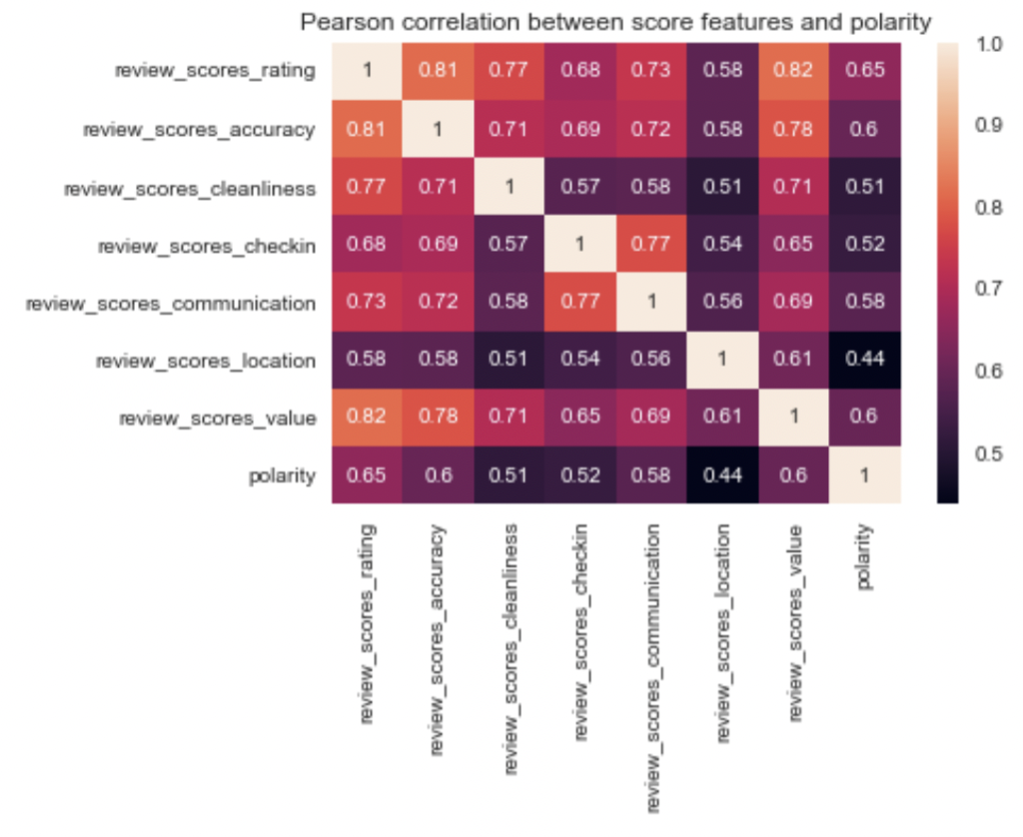
SENTIMENT ANALYSIS – CORRELATION BETWEEN FEATURES AND POLARITY
We have checked the correlation between polarity feature
and other rating scores.
We observed that there is a significant relation between all of them.
The highest correlation was observed with the overall rating
(review_scores_rating).
The lowest correlation was between polarity and reviews_score_location.
This means that location does not play a huge role in terms of
guest reviews during their stay in an Airbnb apartment in London.
Recommendation System
Price Prediction
Sentiment Analysis
Notes:
Polarity score is a metric ….

Slide 21
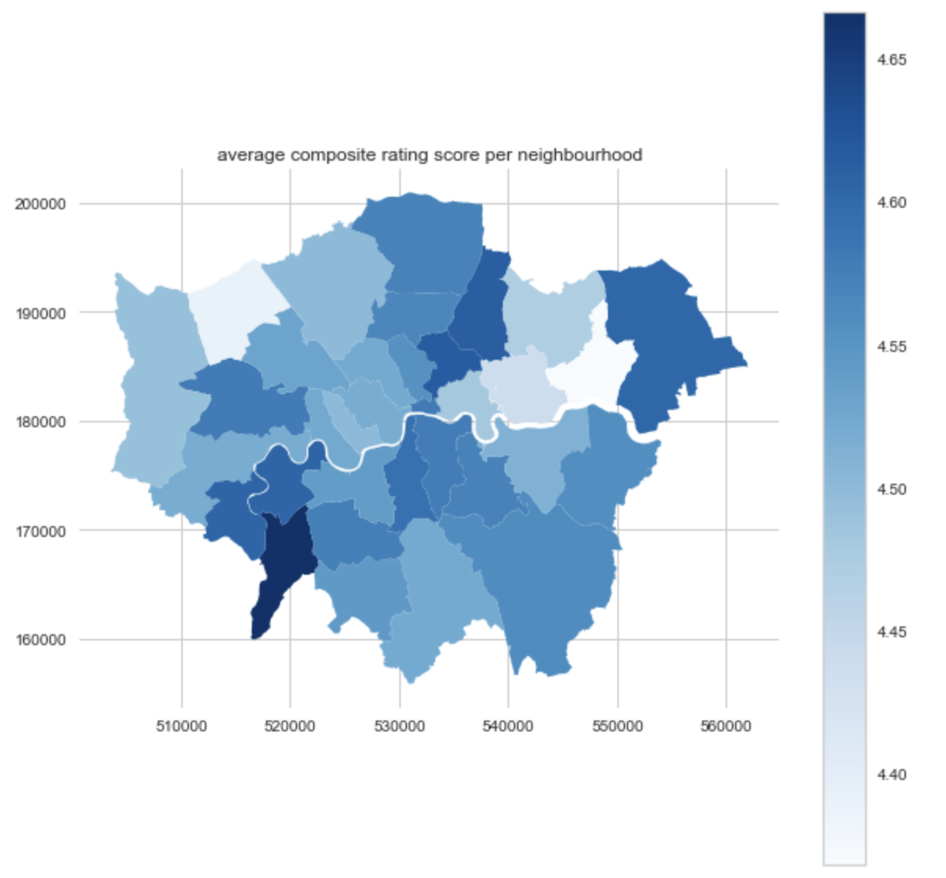
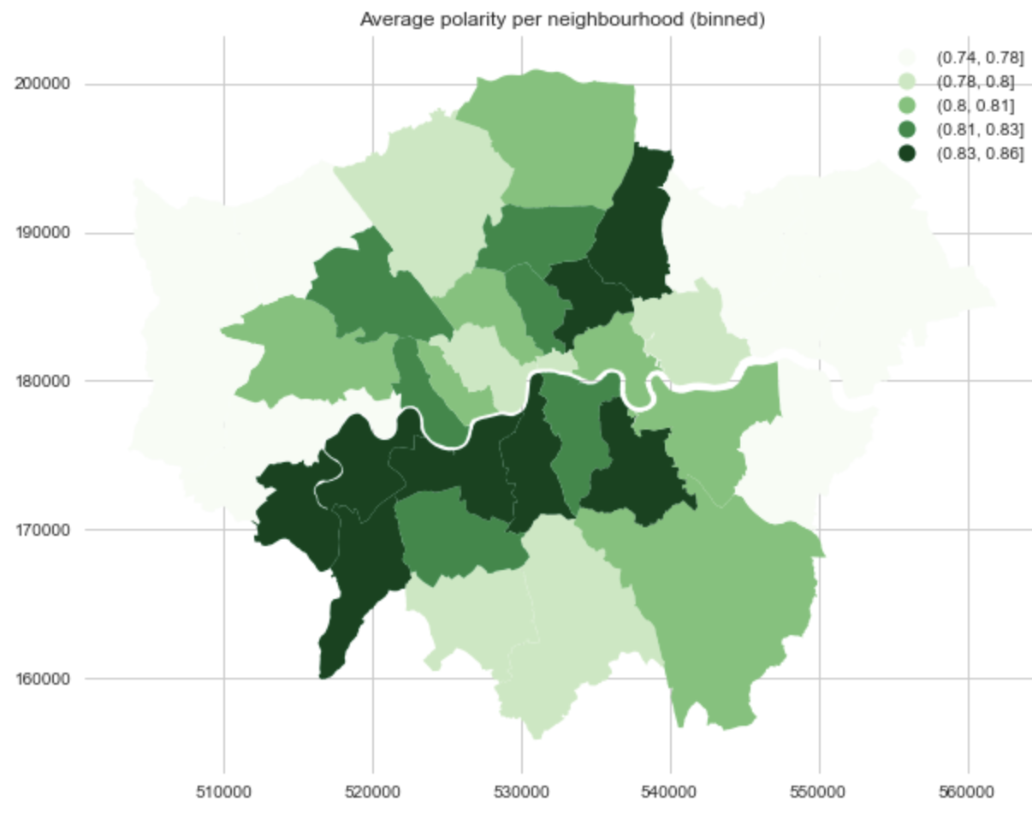
EXPLORING NEIGHBORHOODS
We have looked at is the distribution of ratings and polarity scores across different neighborhoods in London by considering the average composite rating score as well as the average polarity per neighborhood:
The average composite rating score and polarity scores are quite high. Some neighborhoods tend to perform better on all metrics
(South-Western part of London).
Recommendation System
Price Prediction
Sentiment Analysis
Notes:
Why does South-West London Perform the Best?
Kingston upon Thames, historically a royal borough.
Residential area, ‘more wealthy -> upon Thames’, upstream of the Thames,
around 1h public transport from the city center + around 1h public transport from Heathrow Airport
Convenient middle ground.

Slide 22
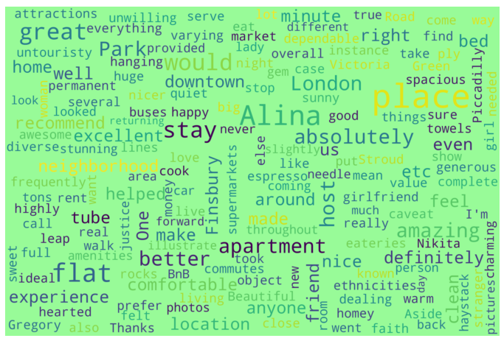
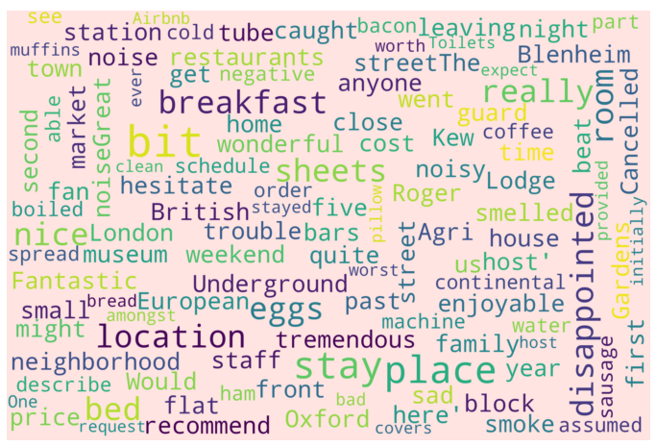
INVESTIGATING POSITIVE AND NEGATIVE COMMENTS
We have used ‘WordClouds’ to discover what visitors applaud or complain about:
POSITIVE COMMENTS
NEGATIVE COMMENTS
Recommendation System
Price Prediction
Sentiment Analysis
Notes:
Seems like successful listings have: “buses, downtown, park, spacious” => i.e. location, location, location
Seems like poorly performing listings have: “cold, tube, noise” => i.e. the listing has poor location, amenities are lackluster

Slide 23
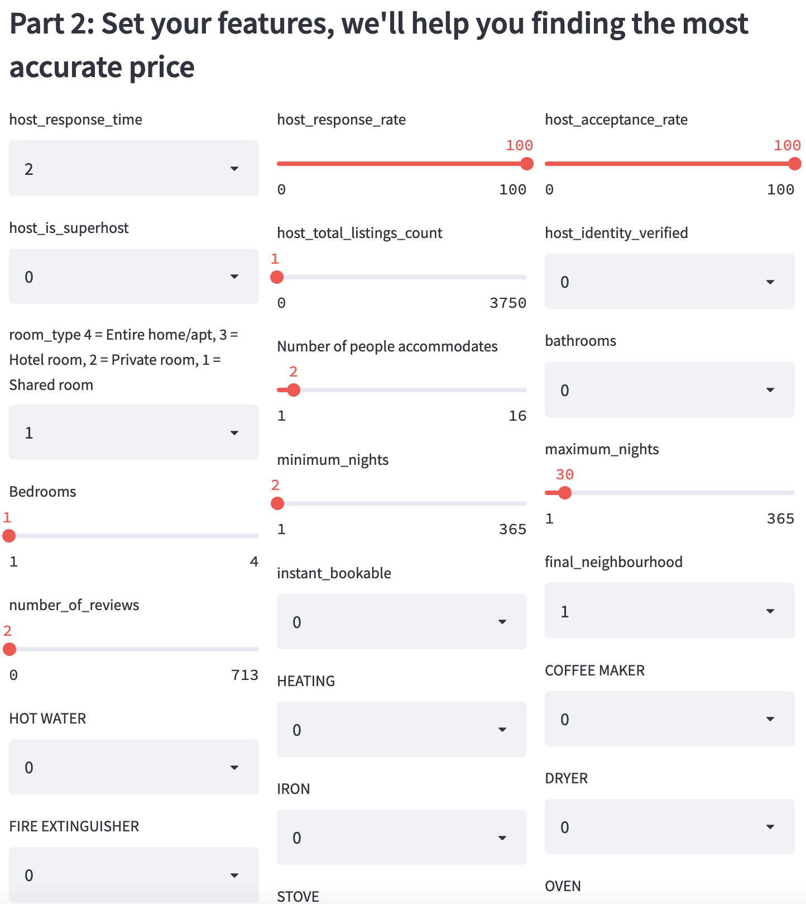
IMPACT ON AIRBNB’S BUSINESS MODEL AND REVENUE
‘Airbnb Premium’
Subscription for landlords
Recommendation on pricing, advertisement and description
Insights into what is valued by guests

Slide 24
THANK YOU!
Questions?

Slide 25
IMPACT ON AIRBNB’S BUSINESS MODEL AND REVENUE
APPENDIX
Codes, analysis, and further explanations…

Slide 26

GITHUB REPOSITORY
https://github.com/fabriziorocco/Airbnb-Project

Slide 27
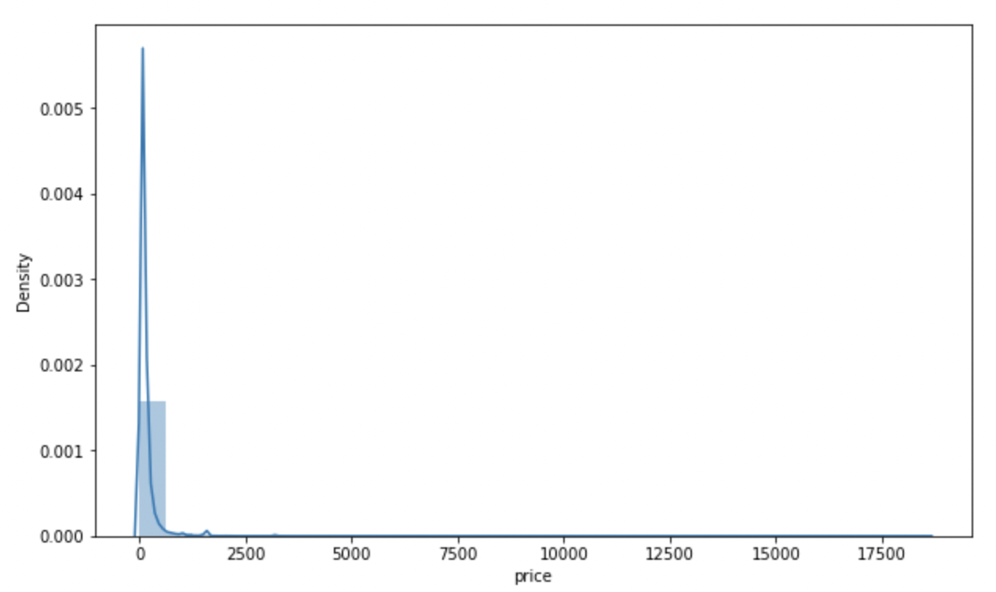
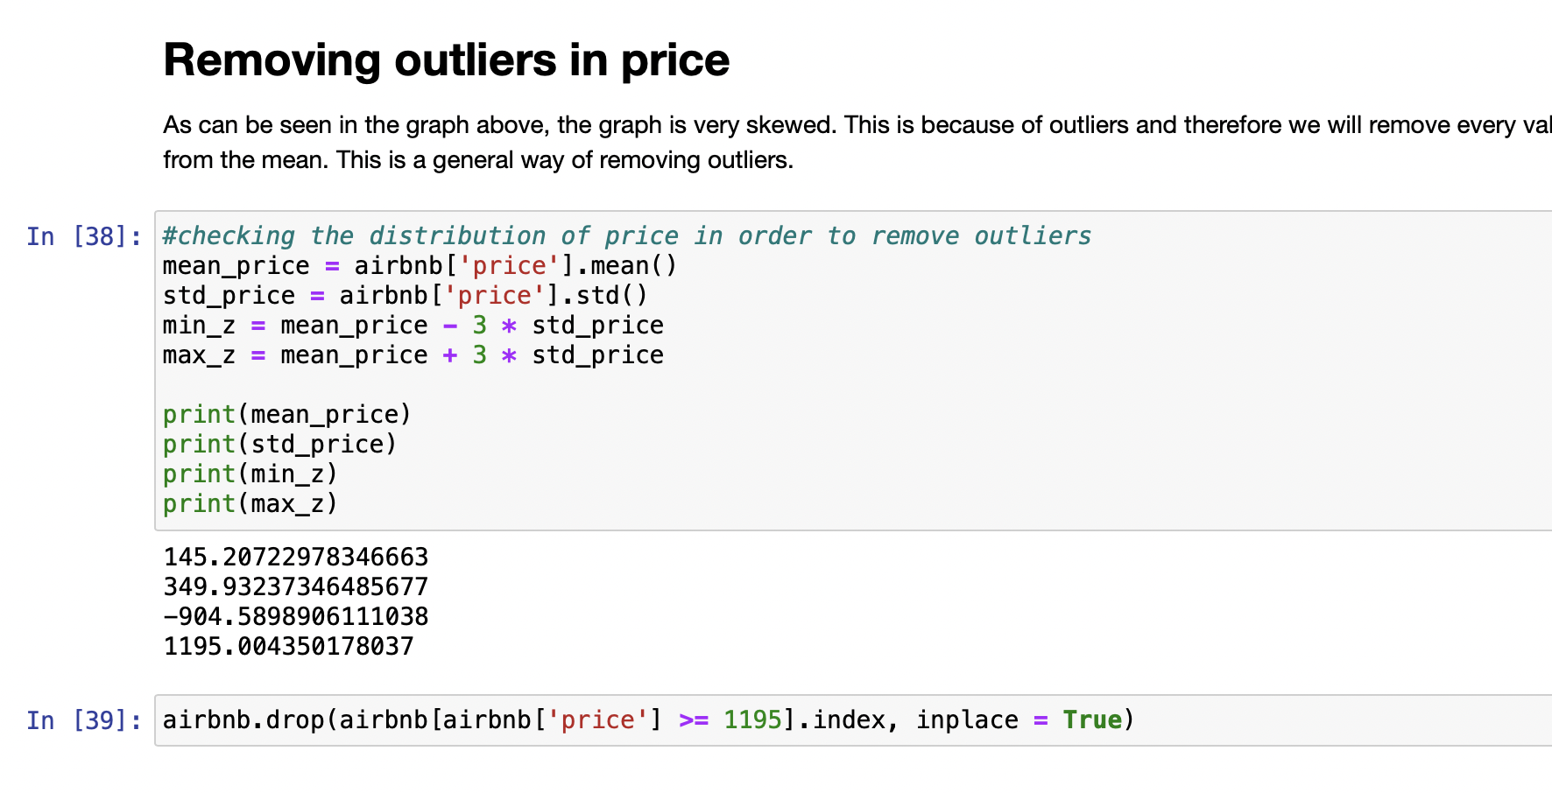
REMOVING OUTLIERS
Price range of Airbnb London Data contains extreme values.
Therefore, we have removed the instances with more than or equal to 1195.
Recommendation System
Price Prediction
Sentiment Analysis

Slide 28
PREPROCESSING DATA
Label-Encoded | One-hot Encoded | Filled with Medians
host_response_time | host_is_superhost | host_response_time
room_type | host_identity_verified | host_response_rate
host_since_year | instant_bookable | host_acceptance_rate
final_neighborhood |  | review_scores_rating
 |  | review_scores_checkin
 |  | review_scores_accuracy
 |  | review_scores_cleanliness
 |  | review_scores_communication
 |  | review_scores_location
 |  | review_scores_value
 |  | reviews_per_month
Recommendation System
Price Prediction
Sentiment Analysis

Slide 29
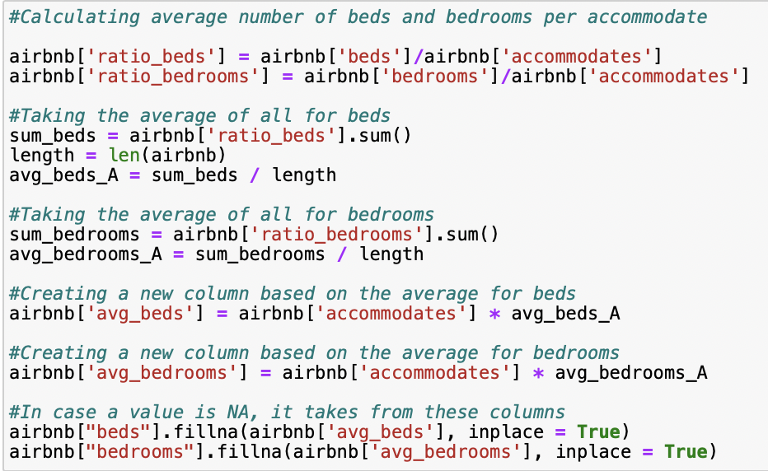
FILLING MISSING VALUES
We have created two new columns: ‘beds’ and ‘bedrooms’
We computed the average number of beds and bedrooms per accommodate per apartment
We added these all up, to divide by the length of the dataset to generate the average
We use the average number of beds per person, to multiply with the number of accommodates
Then, all missing values in the original beds and bedrooms are filled with the value created at step 3.
Recommendation System
Price Prediction
Sentiment Analysis

Slide 30

FEATURE ENGINEERING
We computed the average bedrooms and bathrooms per person to include in as a feature. The reason for this is that both bedrooms, bathrooms and accommodates have a lot of predictive power in the model.
Recommendation System
Price Prediction
Sentiment Analysis

Slide 31
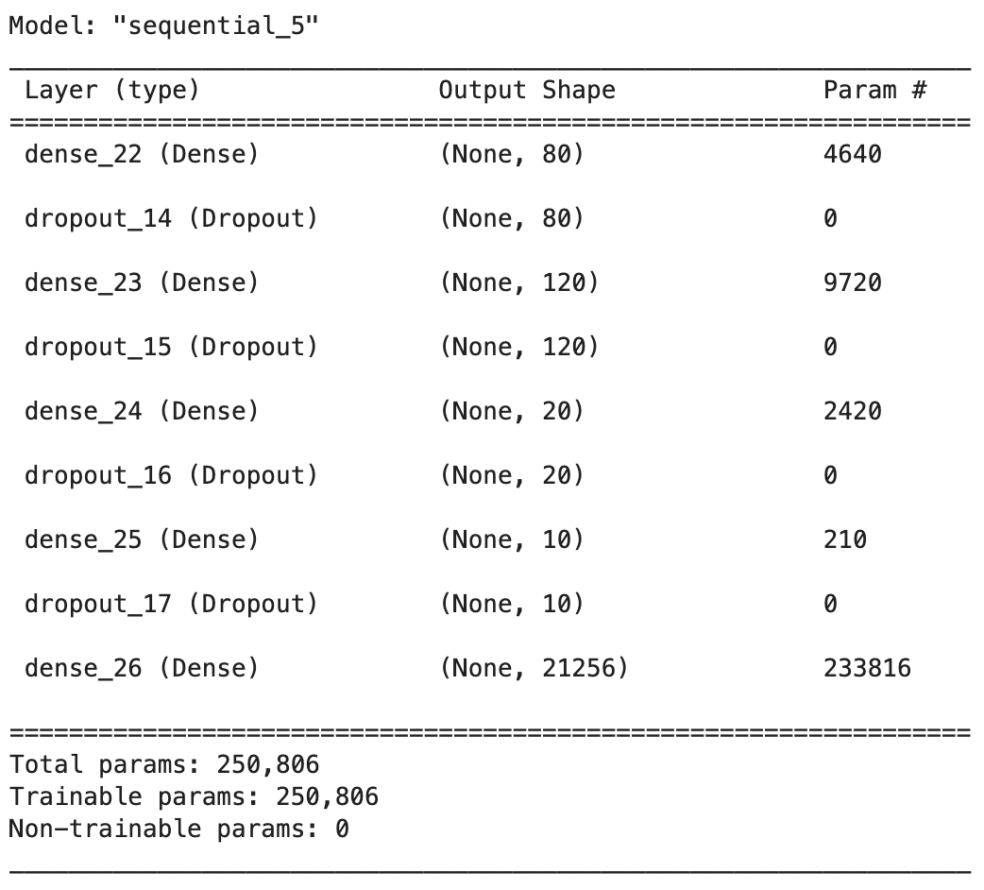
NEURAL NETWORK WITH KERAS
Parameter | Value
Epochs | 200
Batch Size | 128
Callbacks | Early stopping monitoring
Optimizer | Adam
Loss | Mean Absolute Error
Recommendation System
Price Prediction
Sentiment Analysis

Slide 32
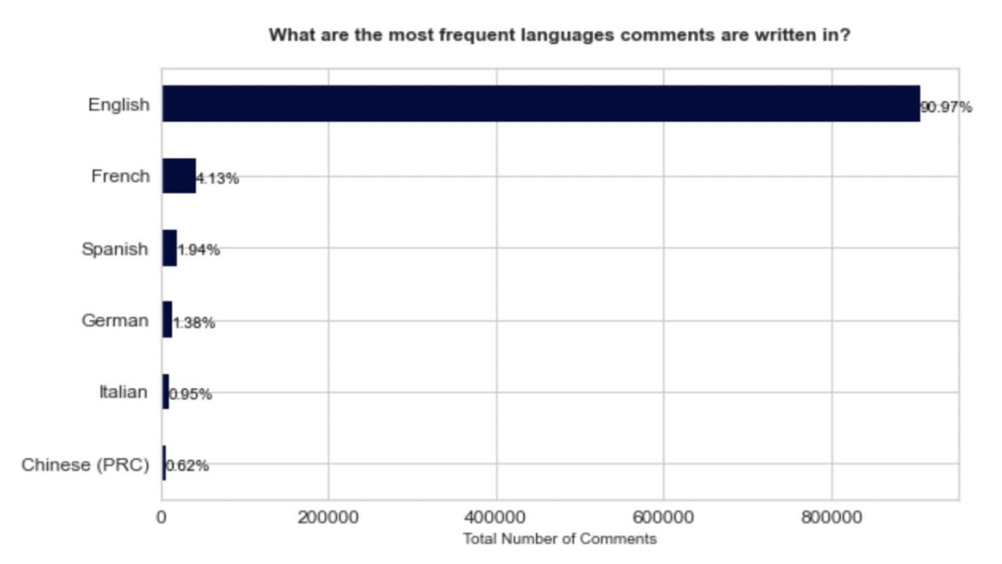
PREPROCESSING DATA – DETECTING LANGUAGES
In a touristic Airbnb location such as London, it is common that some reviews are not in English.
Thus, we have looked at the occurrence and frequency of other languages using the ‘langdetect’ library.
The ‘langdetect’ function has given an error due to:
emojis (e.g. "⭐️") that were used as comments,
expressive punctuation that was given as the only comment (e.g. "!!!!!!!!"),
other non-interpretable combinations of full stops, brackets and special characters.
We have dropped these rows from the ‘reviews’ dataset to increase interpretability.
Recommendation System
Price Prediction
Sentiment Analysis

Slide 33
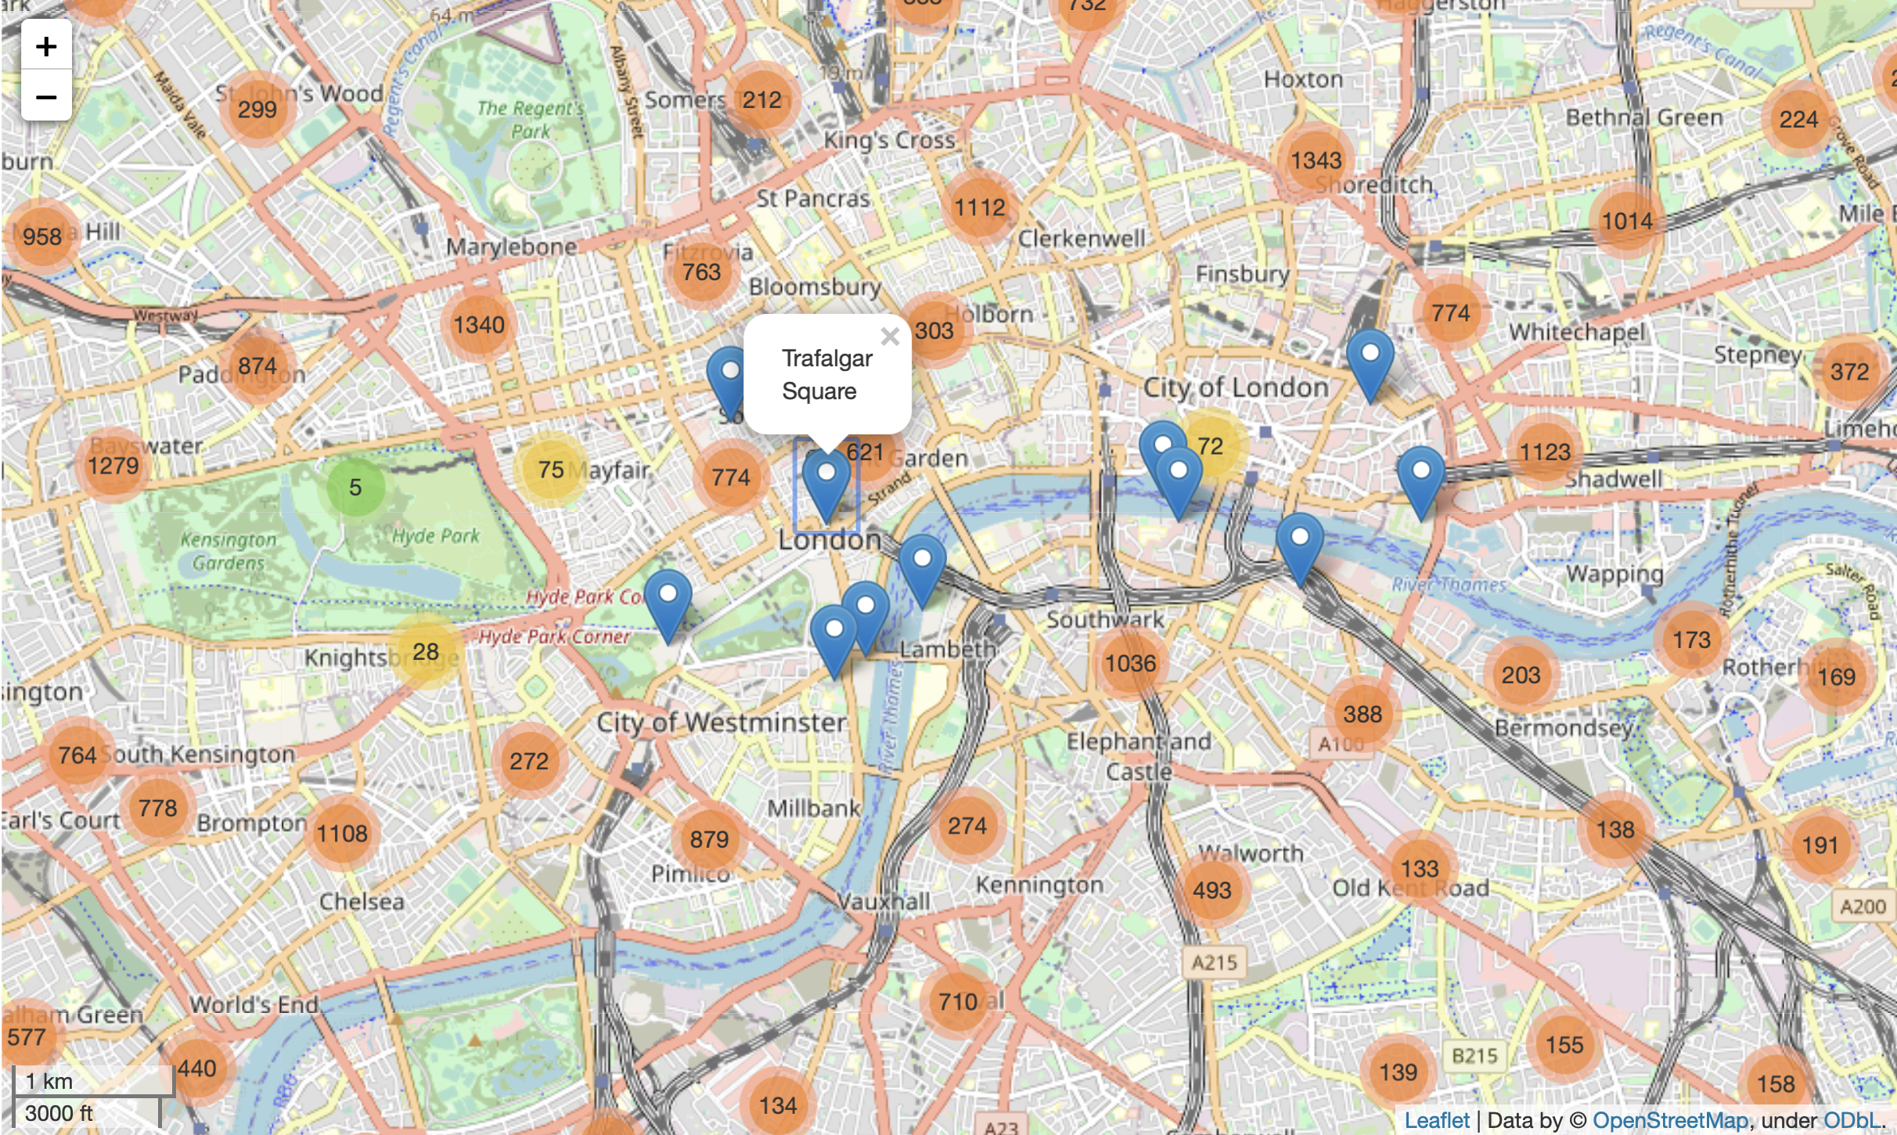
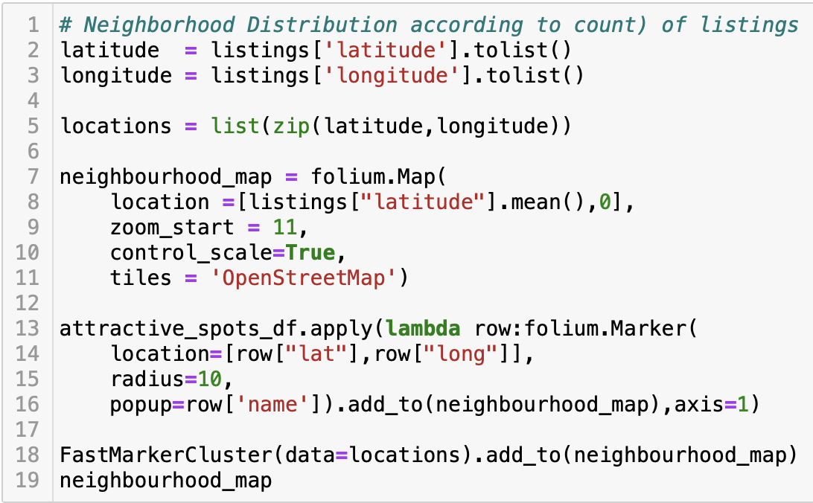
DISTRIBUTION OF LISTINGS ON MAP USING FOLIUM
Recommendation System
Price Prediction
Sentiment Analysis

Slide 34
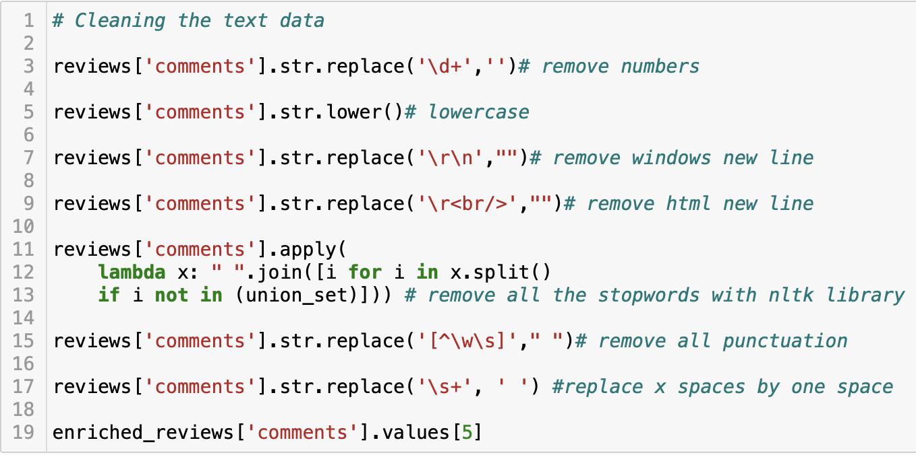
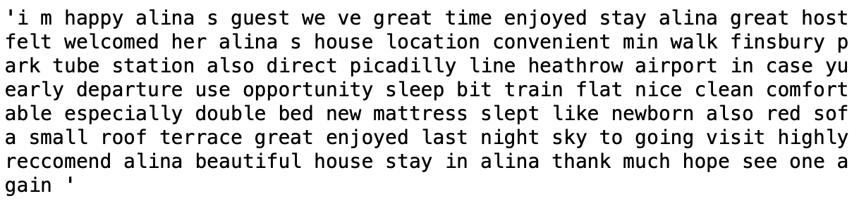
TEXT CLEANING USING REGEX AND NLTK
Recommendation System
Price Prediction
Sentiment Analysis

Slide 35
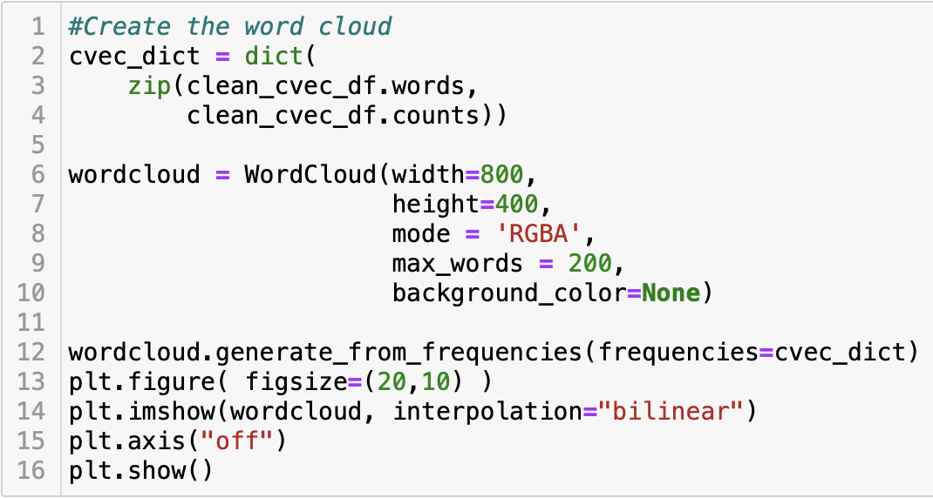
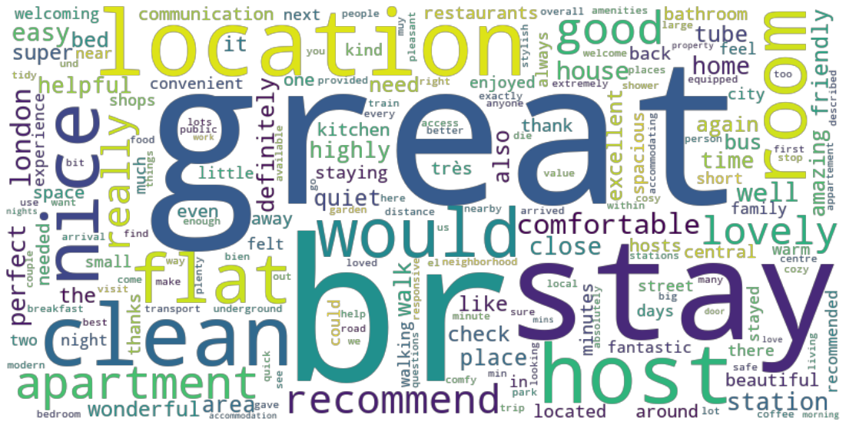
CREATING A WORDCLOUD FROM WORD COUNTS
Recommendation System
Price Prediction
Sentiment Analysis

Slide 36
THE WEB APP: MODULE 1
Recommendation System
Price Prediction
Sentiment Analysis

Slide 37
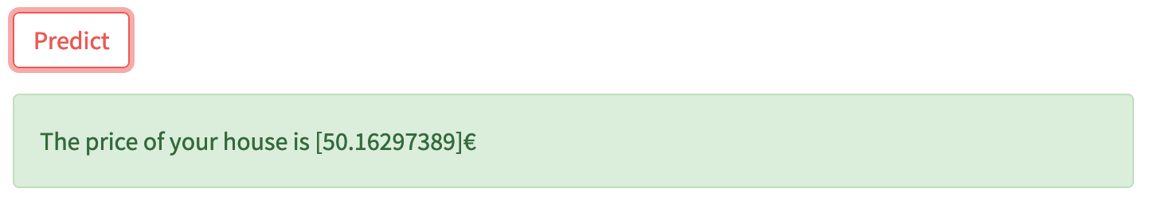
THE WEB APP: MODULE 2
Recommendation System
Price Prediction
Sentiment Analysis

Slide 38
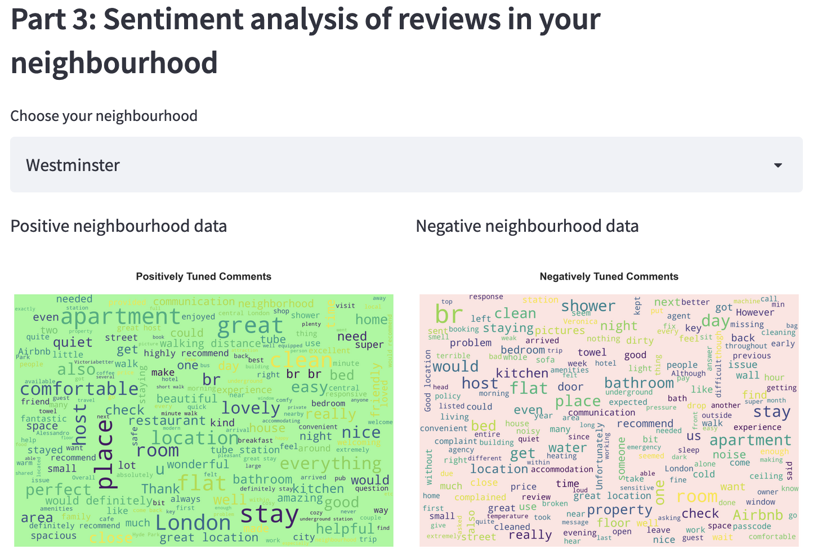
THE WEB APP: MODULE 3
Recommendation System
Price Prediction
Sentiment Analysis

